Slide 1
COVD19 Contact Tracing
Launch of COVID 19 Learning Community
June 4, 2020

Slide 2


COVID 19 Learning Community
Borealis Communities Transforming Policing Fund and The Community Resource Hub are launching several learning including the Divest/Invest learning community and a COVID19 learning community.
Learning communities will be spaces of:
Skills building and training
Tracking trends
Strategizing
Collective tool and resource creation.

Slide 3
Invest/Divest Learning Community
Launch in May
Currently collecting #DefundPolice demands from across the country
Developing principles of a public health budget
Developing research re: what we want in terms of:
  Housing programs
  Mental health programs
  Youth programs
  ?
Nationally networked local organizing

Slide 4
COVID19 Learning Community
Intersections of COVID19 with policing & criminalization
What do we need to learn more about?
What demands are people making?
How can we strategize together?
Complement to COVID19 Policing Project
  Covid19policing.com
  Want to partner? covid19policing@gmail.com

Slide 5
Contact Tracing
States are moving from “stay at home” & restrictions on communities to an individualized/community based approach.
  Test
  Track
  Contain
  (Criminalize)
Contact tracing is the “track” part – find out where a person who has tested positive has been, alert contacts that they have been exposed.
In a growing number of states, quarantine is required after a positive test, exposure, or symptoms
Quarantine is enforced through criminal penalties
Contact tracing could be used to criminalize or suppress participation in protests

Slide 6
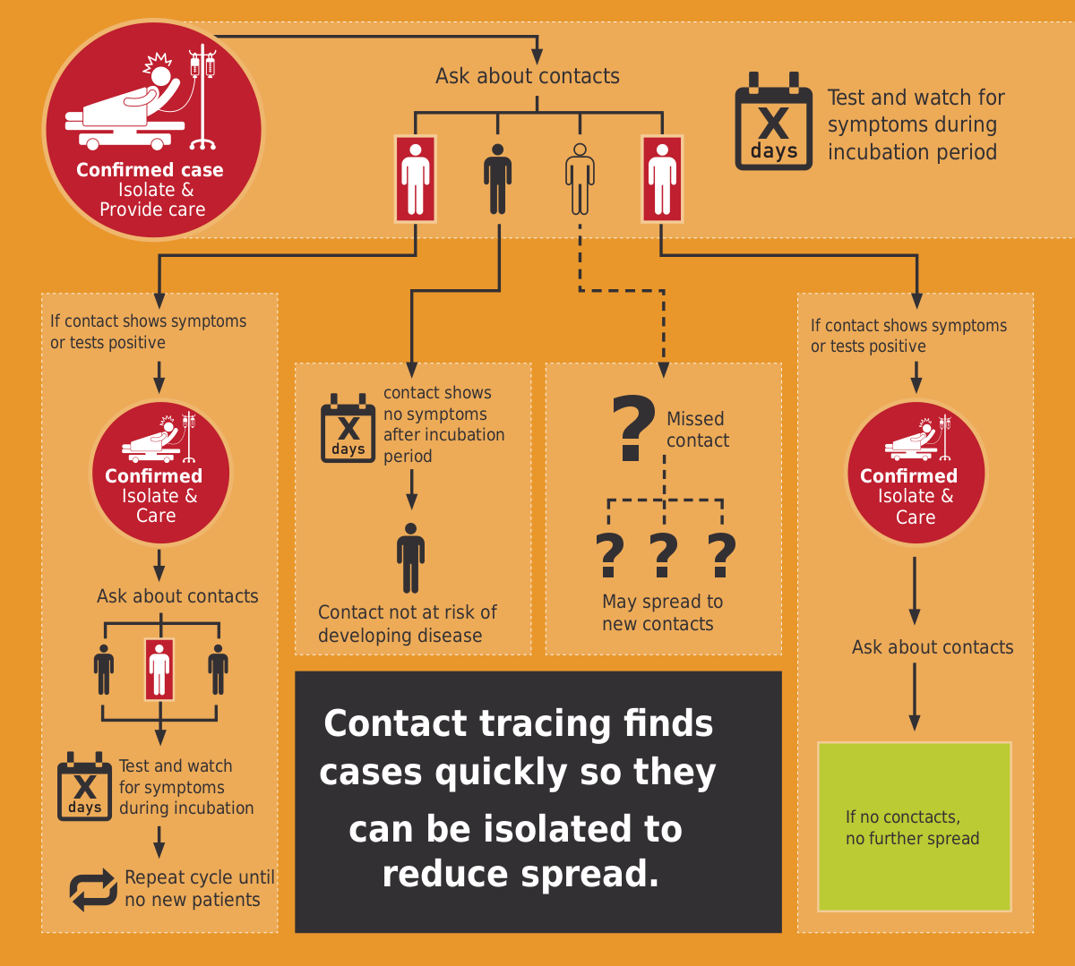

Slide 7
Questions for today
how contact tracing has been used in the past in the context of the HIV epidemic and lessons learned in terms of positive and negatives, especially re: criminalization
how contact tracing infrastructure is being built and how training is happening in this current moment (Bita)
privacy concerns and demands - manual contact tracing
privacy concerns and demands - electronic contact tracing (Neema)
Contact tracing & protest

Slide 9
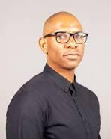
Kenyon Farrow
Kenyon is the senior editor of TheBody/TheBodyPro. He has a distinguished track record working in communities impacted by HIV as an activist, writer, and strategist, stretching back long before he joined our team in late 2017. Kenyon's work has been recognized by many institutions, including Out Magazine's "Out 100" and The Advocate's "40 Under 40." He was also named a "Modern Black History Hero" by Black Entertainment Television.

Slide 10
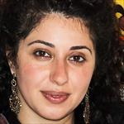
Bita Amani
Bita Amani is an Assistant Professor in the Department of Urban Public Health at Charles Drew University. Her research and practice are focused on (1) the socio-political roots of health and (2) the intersecting relationships between health and politics. Through her pedagogy, she cultivates critical thinking and conversations that complicate ideas of wellness and sickness. In pursuing her work, Amani uses a variety of methods and multi-disciplinary approaches. She infuses history, critical theory, lessons from social movements, and eco-social thinking into her public health and research practice.

Slide 11
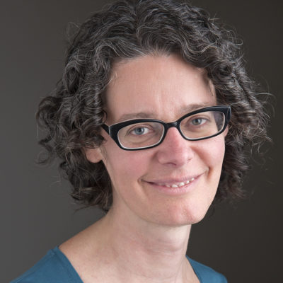
Rose Saxe
Rose Saxe is a Deputy Director of the American Civil Liberties Union’s LGBT & HIV Project. She has specialized in issues of employment and public accommodation discrimination, denial of medical care, family law issues, and the intersection of civil rights for LGBTQ people, and religious freedom and expression, through litigation and state and federal policy advocacy. She previously co-taught the Columbia Law School Gender & Sexuality Law Clinic. She clerked for Judge Sonia Sotomayor on the 2nd U.S. Circuit Court of Appeals and Judge Janet Bond Arterton on the U.S. District Court for the District of Connecticut. Rose received her J.D. from Yale Law School and her B.A. from Georgetown University.

Slide 12
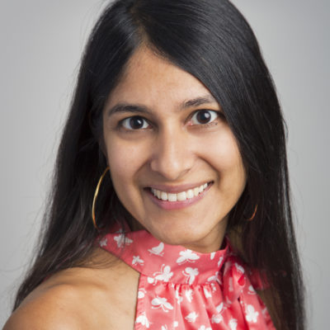
Neema Singh Guliani
Neema Singh Guliani is a senior legislative counsel with the American Civil Liberties Union Washington Legislative Office, focusing on surveillance, privacy, and national security issues. Prior to joining the ACLU, she worked in the Chief of Staff’s Office at DHS, concentrating on national security and civil rights issues. She has also worked as an adjudicator in the Office of the Assistant Secretary for Civil Rights in the Department of Agriculture and was an investigative counsel with House Oversight and Government Reform Committee, where she conducted investigations related to the BP oil spill, contractors in Iraq and Afghanistan, and the Recovery Act. Neema is a graduate of Brown University where she earned a BA in International Relations with a focus on global security and received her JD from Harvard Law School in 2008.

Slide 14
Demands
Anonymity/privacy/protection
Economic/safe housing/social support during quarantine
Job protection during quarantine
Compensation during quarantine
What else?

Slide 15
Questions?
Other topics?

